Slide 1


Unstructured Data
Selected Examples with References

Slide 2
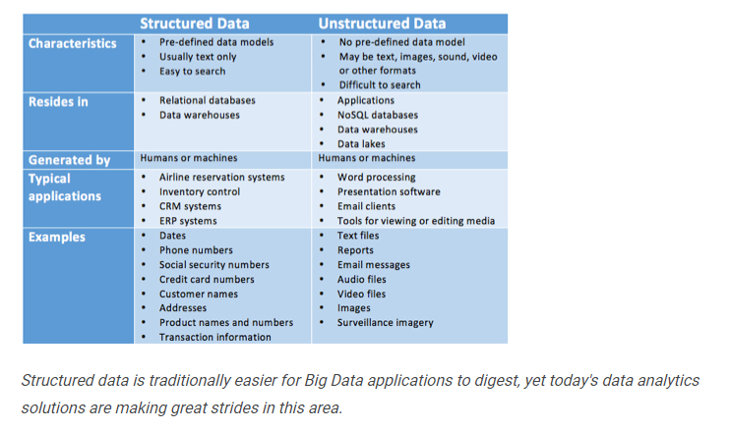
Good side-by-side comparison of
structured and unstructured data
https://www.datamation.com/big-data/structured-vs-unstructured-data.html

Slide 3
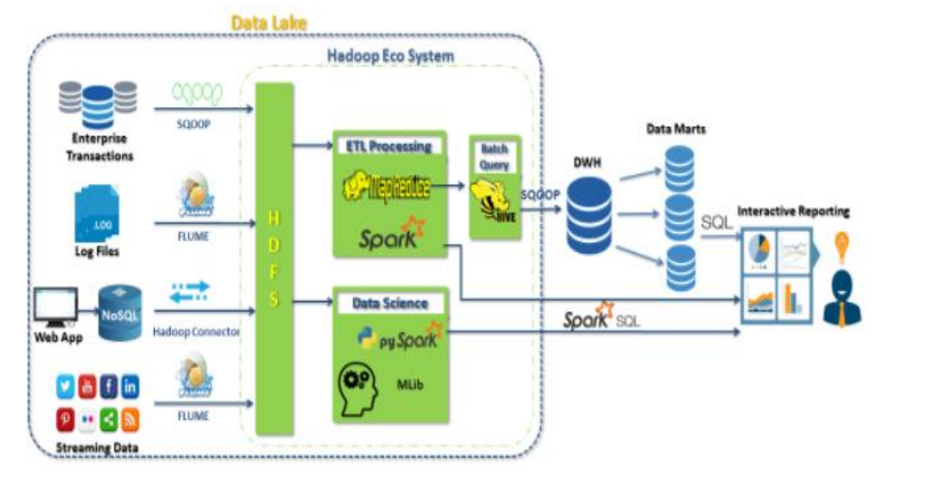
Data Lakes are very popular. Using a design
similar to what you see here, both unstructured
and structured data can be leveraged. In this
Example it is upstream of the data warehouse.
https://www.datasciencecentral.com/profiles/blogs/beyond-datawarehouse-the-data-lake

Slide 4
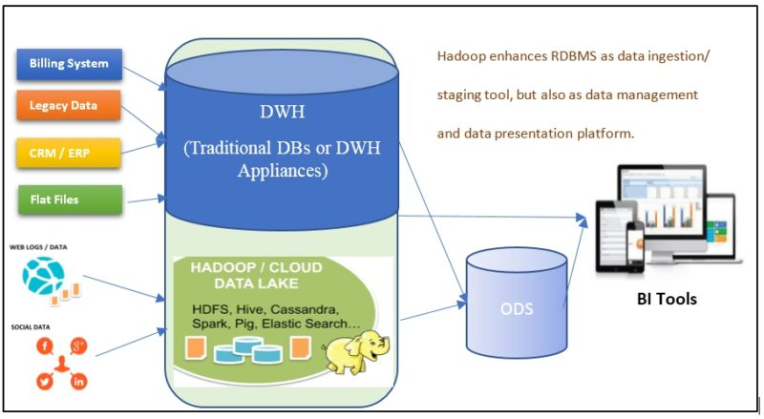
Here you can see
it coexisting with a
traditional warehouse
https://blogs.mastechinfotrellis.com/can-big-data-replace-edw

Slide 5
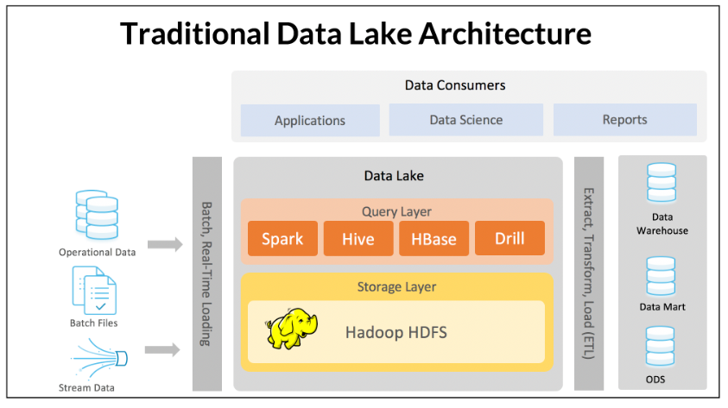
Warning: Heavily influenced by the memSQL vendor
https://www.memsql.com/blog/webinar-data-lake-age-of-ml-ai/

Slide 6
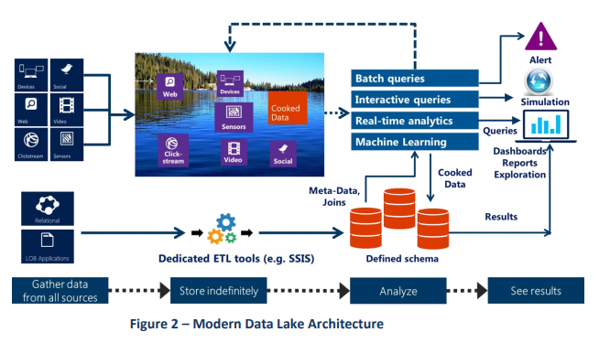
Warning: Heavily influenced by the vendor. Still a good reference for data lakes in Azure
http://innolitica.com/wp-content/uploads/2013/04/White_Paper_Azure_Data_Lake_Store_Innolitica_Labs.pdf

